Slide 1


Introduction To
&
{JSON}
Prepared by : Aep Hidayatuloh
Email : aephidayatuloh.mail@gmail.com
GitHub : https://github.com/aephidayatuloh
Powered by

Slide 2


{Aep Hidayatuloh}
Nama Panggilan | : Aep
Daerah Asal | : Cikarang, Bekasi
Tempat Tinggal | : Cikarang, Bekasi
Angkatan | : STK 46
Pekerjaan | : Senior Data Analyst at Starcore Analytics
 | Customer Value Management at PT Asuransi Jiwa Sequislife
 | Statistician & App Developer at PT Ganesha Cipta Informatika
R Indonesia
https://t.me/GNURIndonesia

Slide 3
{Pre-requisite}
Internet Connection
Software Installed:
R program (https://cran.r-project.org/)
RStudio (https://www.rstudio.com/products/rstudio/download/)
Materials:
Download at https://github.com/aephidayatuloh/basic_r_json
R Packages:
jsonlite : install.packages("jsonlite")
dplyr : install.packages("dplyr")
ggplot2 : install.packages("ggplot2")
tidyr : install.packages("tidyr")
Use install.packages(c("jsonlite", "dplyr", "ggplot2", "tidyr")) to install all those packages or simply install.packages(c("tidyverse", "jsonlite")) to install jsonlite, dplyr, ggplot2, tidyr and other useful packages.

Slide 4








{Import Data Into R}
etc.

Slide 5
{Import Data Into R}
# Import data from ~.txt file
x1 <- read.table("path/to/file.txt", header = TRUE)
# Import data from ~.csv file
x2 <- read.csv("path/to/file.csv", header = TRUE)

Slide 6
{Objects In R}
Vector: 1D same type
Matrix: 2D same type
Array: matrix with > 2D
Dataframe: mostly 2D and can be different type for each column
List:
Can contains different R object
No coercion

Slide 7
{List}
# Consist of different object types
list(c("Feb","Mar","Apr"), matrix(c(3,9,5,1), nrow = 2), list("green",12.3))
# coercion
c("a", 1, 2) # coerced to character
list("a", 1, 2) # No coercion

Slide 8
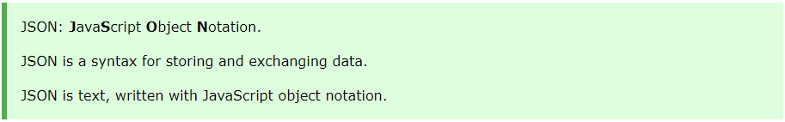


{JSON}

Slide 9
{JSON} – Syntax Rules
JSON syntax is derived from JavaScript object notation syntax:
Data is in name/value pairs
Data is separated by commas
Curly braces hold objects, {objects} → value of data
Square brackets hold arrays [arrays] → List
{"name":"John", "age":38}
{"key1":"value1", "key2":value2}

Slide 10
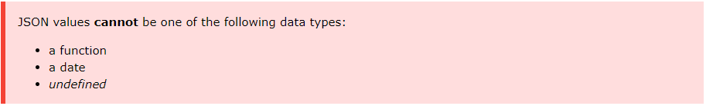
{JSON} – Data Types
In JSON, values must be one of the following data types:
"string"
number
object (JSON object)
array
boolean
null

Slide 11
{JSON} – Data Types
String
{ "name":"John" }
Numeric
{ "age":38 }
JSON Object
{ "employee":{ "name":"John", "age":30, "city":"New York" } }
Array
{
"employees":[ "John", "Anna", "Peter" ]
}
Boolean
{ "male":true }
Null
{ "midname":null }
How about Date values?
Date as string → convert in R as date

Slide 12
Simplest {Format}

Slide 13
{JSON} – Format
Format 1:
{
"var1":[1, 2],
"var2":["value1", "value2"],
"var3":[623.3, 515.2]
}
Format 2:
[
[1, "value1", 623.3],
[2, "value2", 515.2]
]
Format 3:
[
{
"var1":1,
"var2":"value1",
"var3":623.3
},
{
"var1":2,
"var2":"value2",
"var3":515.2
}
]

Slide 14
Let’s Get {Dirty}!

Slide 15
{JSON} – Text
# Read JSON text
json1 <- '{
"ID":[1,2,3,4,5],
"Name":["Rick","Dan","Michelle","Ryan","Gary"],
"Salary":[623.3,515.2,611,729,843.25],
"StartDate":["1/1/2012","9/23/2013","11/15/2014","5/11/2014","3/27/2015"],
"Dept":["IT","Operations","IT","HR","Finance"]
}’
x1 <- fromJSON(json1)
str(x1)
# Into Dataframe
x1 <- as.data.frame(x1, stringAsFactor = FALSE)
str(x1)

Slide 16
{JSON} – Text
# Read JSON text
json2 <- '[
[1, "Rick", 623.3, "1/1/2012", "IT"],
[2, "Dan", 515.2, "9/23/2013", "Operations"],
[3, "Michelle", 611, "11/15/2014", "IT"],
[4, "Ryan", 729, "5/11/2014", "HR"],
[5, "Gary", 843.25, "3/27/2015", "Finance"]
]'
x2 <- fromJSON(json2)
str(x2)
# Into Dataframe
x2 <- as.data.frame(x2, stringAsFactor = FALSE)
str(x2)

Slide 17
{JSON} – Text
json3 <- '[
{ "ID":1, "Name":"Rick", "Salary":623.3, "StartDate":"1/1/2012", "Dept":"IT" },
{ "ID":2, "Name":"Dan", "Salary":515.2, "StartDate":"9/23/2013", "Dept":"Operations" },
{ "ID":3, "Name":"Michelle", "Salary":611, "StartDate":"11/15/2014", "Dept":"IT" },
{ "ID":4, "Name":"Ryan", "Salary":729, "StartDate":"5/11/2014", "Dept":"HR" },
{ "ID":5, "Name":"Gary", "Salary":843.25, "StartDate":"3/27/2015", "Dept":"Finance" }
]'
x3 <- fromJSON(json3)
str(x3)

Slide 18
{JSON} – Local File
# Read JSON data from local .json file
jsondata <- fromJSON("RJson/datajson.json")
str(jsondata)
str(jsondata$data)

Slide 19
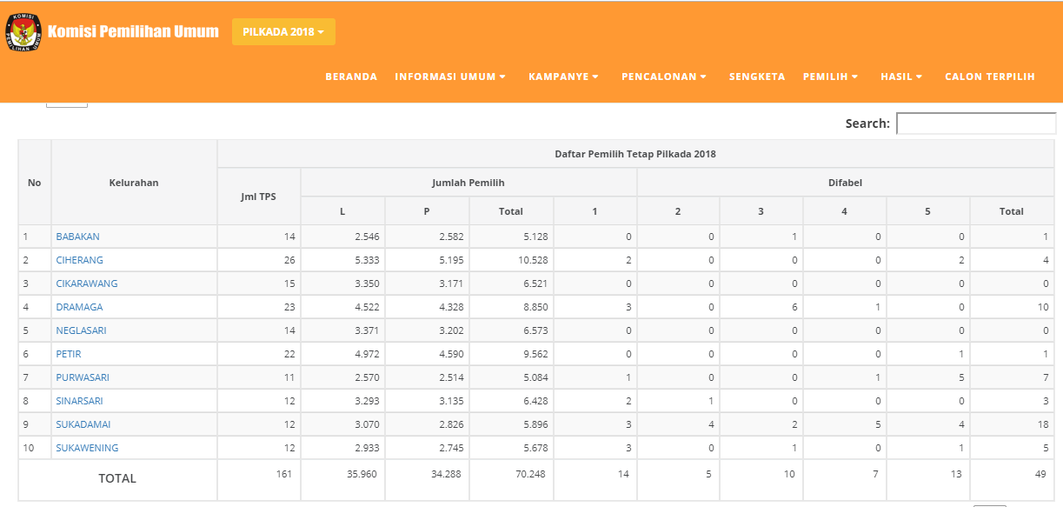
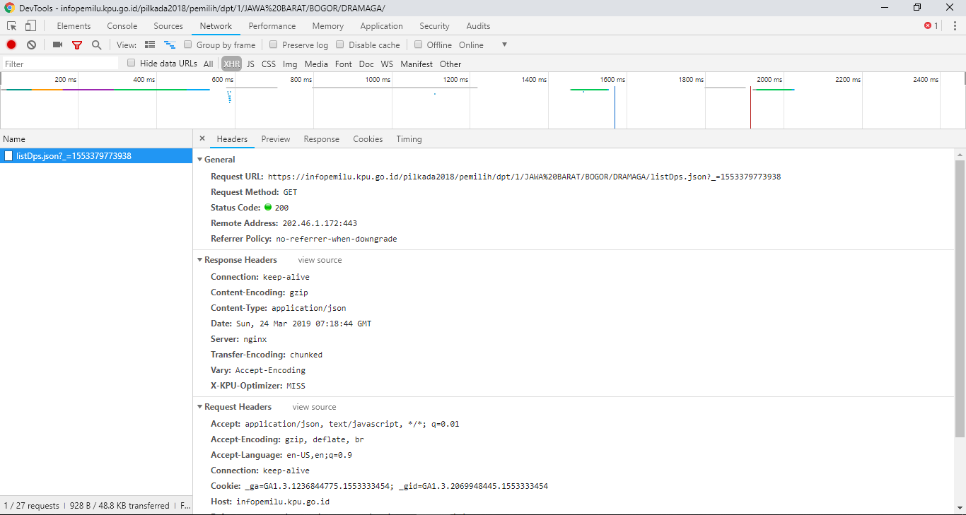
{JSON} – From Web
Read JSON data from website: https://infopemilu.kpu.go.id/

Slide 20
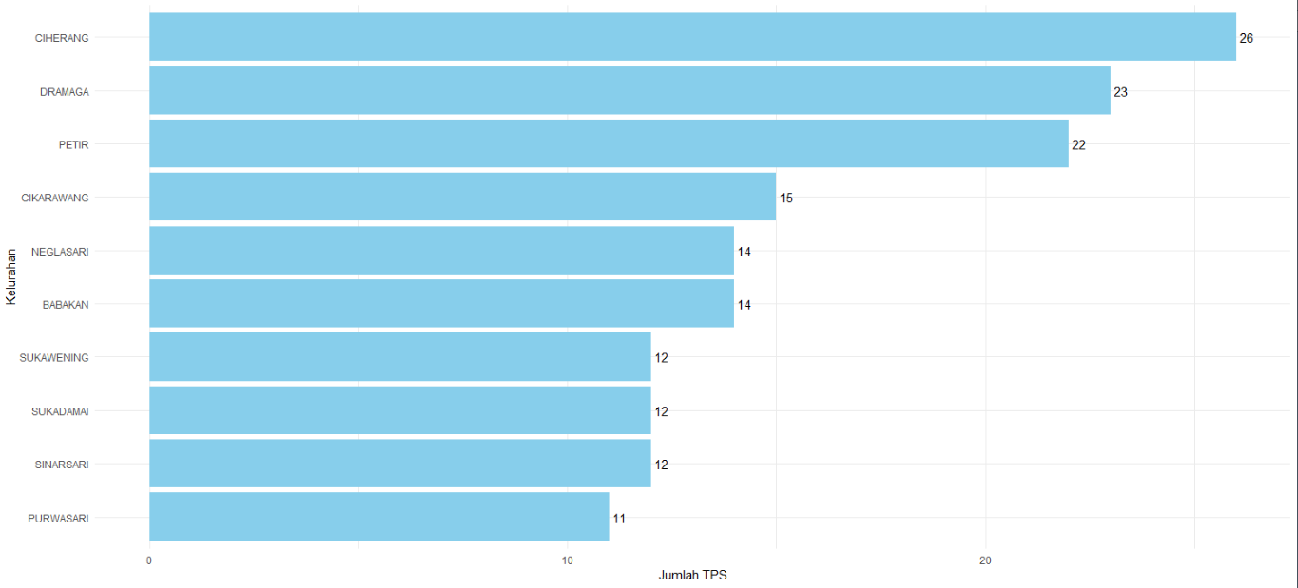
{JSON} – Visualization
Read JSON data from website: https://infopemilu.kpu.go.id/

Slide 21
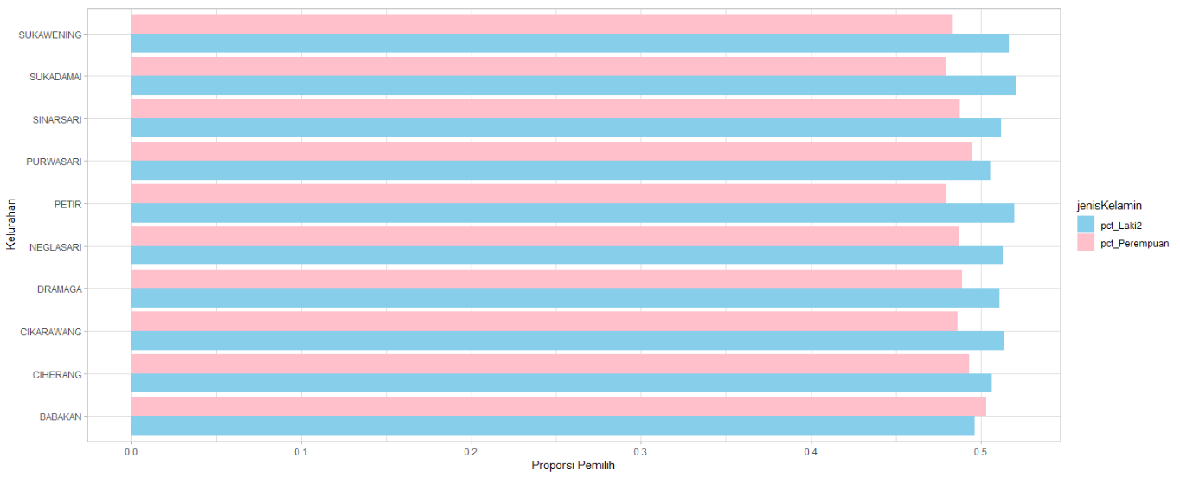
{JSON} – Visualization
Read JSON data from website: https://infopemilu.kpu.go.id/

Slide 22
Next Level! {Nested JSON}

Slide 23
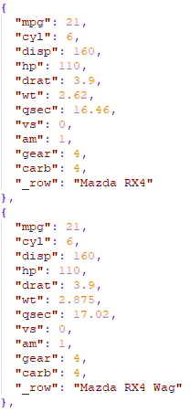

{JSON} – Simple Format

Slide 24
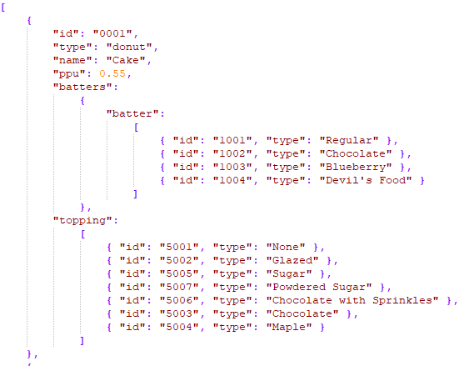

{JSON} – Nested

Slide 25
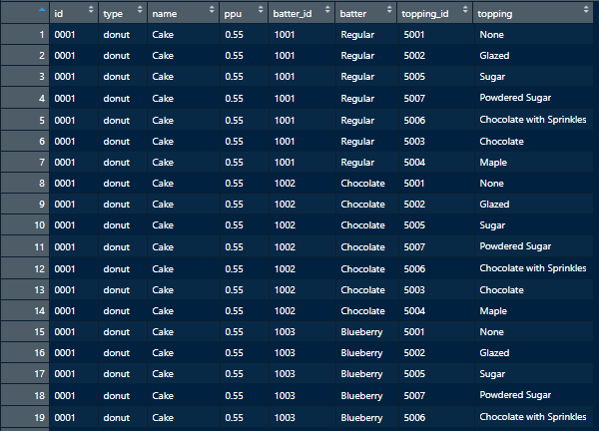
{JSON} – (Desired) Tidy Data
recipes <- fromJSON("RJson/recipes.json")
str(recipes)
batters <- recipes %>%
as_tibble() %>%
mutate(batters = batters[[1]]) %>%
unnest(batters) %>%
rename(batter_id = id1, batter = type1)
toppings <- recipes %>%
as_tibble() %>%
unnest(topping) %>%
rename(topping_id = id1,
topping = type1)
tidy_recipes <- left_join(batters,
toppings)

